Slide 1
Random Variable

Slide 2
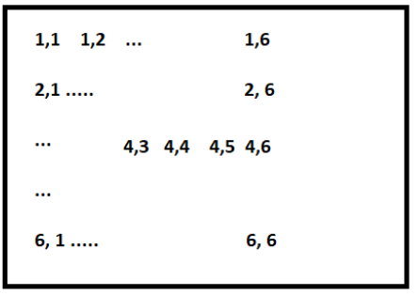

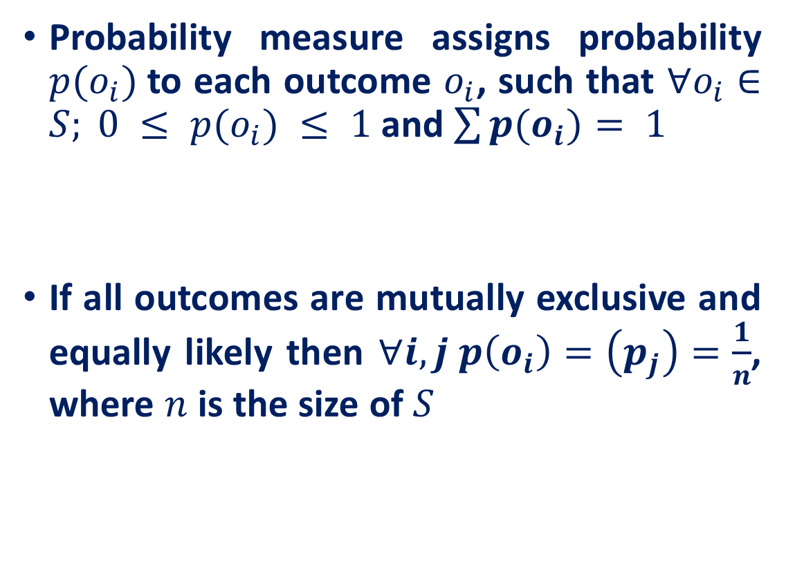
Random Variable
Probability measure assigns probability $p(o_{i})$to each outcome $o_{i}$, such that $∀o_{i}∈S; 0 ≤ p(o_{i}) ≤ 1$ and $\sum{p(o_{i})}= 1$
If all outcomes are mutually exclusive and equally likely then $∀i, j p\left(o_{i}\right)=\left(p_{j}\right)=\frac{1}{n}$, where $n$ is the size of $S$
Sample space for 2-dice rolling experiment, $\left|S\right|=36$

Slide 3
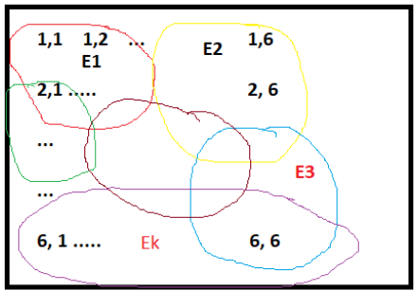
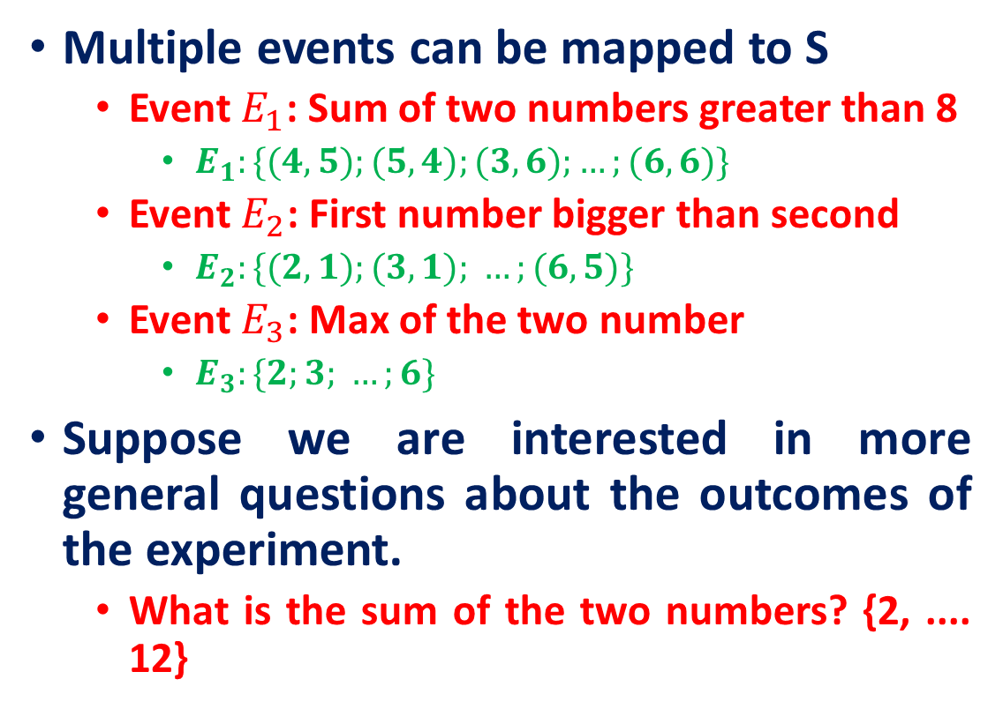
Random Variable
Multiple events can be mapped to S
Event $E_{1}$: Sum of two numbers greater than 8
$E_{1}:\{(4,5);(5,4);(3,6);…;(6,6)\}$
Event $E_{2}$: First number bigger than second
$E_{2}:\{(2,1);(3,1); …;(6,5)\}$
Event $E_{3}$: Max of the two number
$E_{3}:\{2;3; …;6\}$
Suppose we are interested in more general questions about the outcomes of the experiment.
What is the sum of the two numbers? {2, .... 12}
Sample space for 2-dice rolling experiment, $\left|S\right|=36$

Slide 4
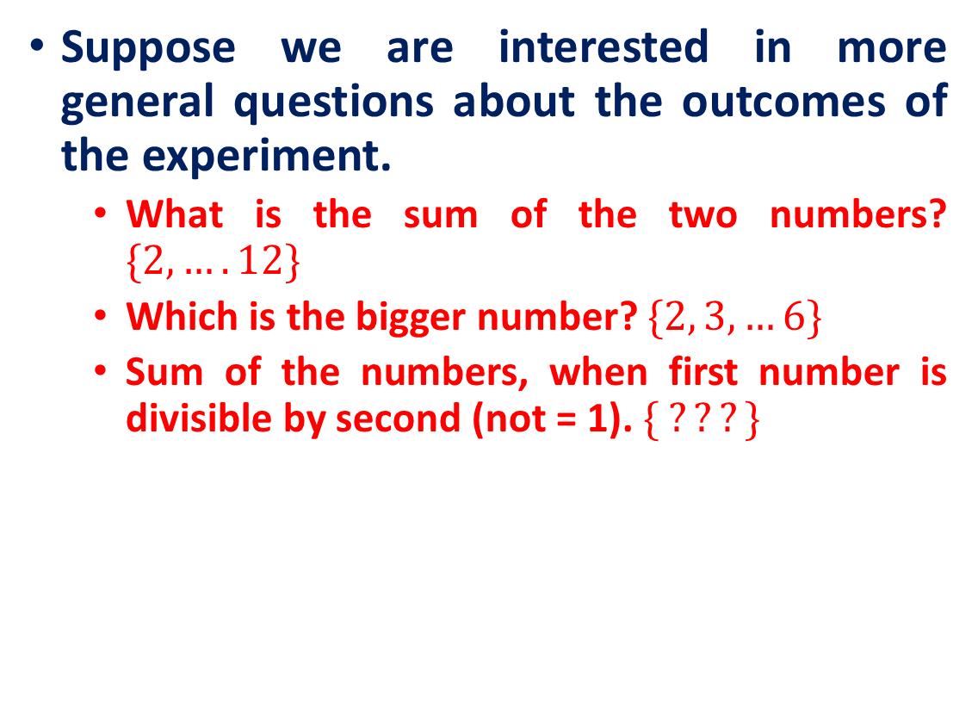

Random Variable
Suppose we are interested in more general questions about the outcomes of the experiment.
What is the sum of the two numbers? $\{2, …. 12\}$
Which is the bigger number? $\{2, 3, …6\}$
Sum of the numbers, when first number is divisible by second (not = 1). $\{ ???\}$
Sample space for 2-dice rolling experiment, $\left|S\right|=36$
Define a function that maps all outcomes in S to a set of values
$$f:S→R$$

Slide 5
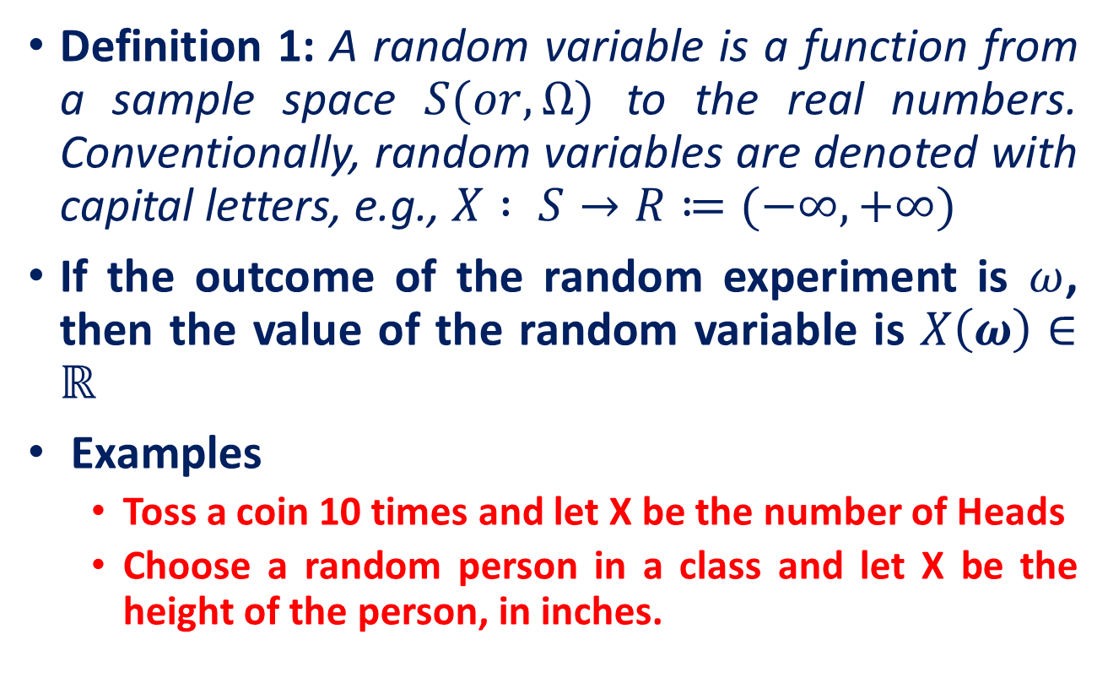
Random Variable
Definition 1: A random variable is a function from a sample space $S(or, Ω)$ to the real numbers. Conventionally, random variables are denoted with capital letters, e.g., $X : S→R≔(−∞,+∞)$
If the outcome of the random experiment is $ω$, then the value of the random variable is $X\left(ω\right)∈ℝ$
Examples
Toss a coin 10 times and let X be the number of Heads
Choose a random person in a class and let X be the height of the person, in inches.

Slide 6
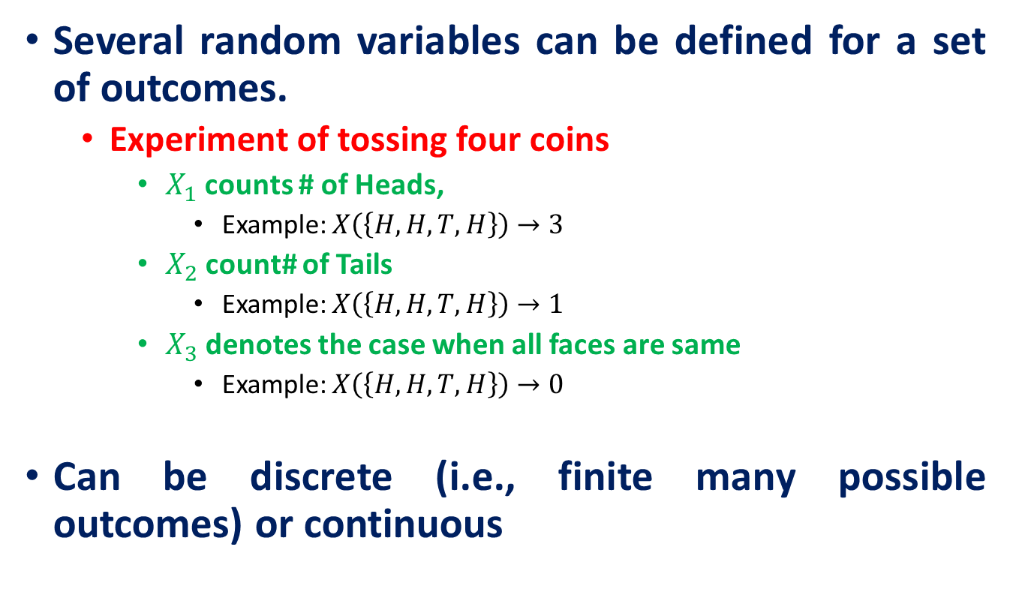
Random Variable
Several random variables can be defined for a set of outcomes.
Experiment of tossing four coins
$X_{1}$ counts # of Heads,
Example: $X\left(\left\{H,H,T,H\right\}\right)→3$
$X_{2}$ count# of Tails
Example: $X\left(\left\{H,H,T,H\right\}\right)→1$
$X_{3}$ denotes the case when all faces are same
Example: $X\left(\left\{H,H,T,H\right\}\right)→0$
Can be discrete (i.e., finite many possible outcomes) or continuous

Slide 7
Discrete Random Variable
Random variables that can assume a countable number (finite or infinite) of values are called discrete.
Examples
Experiment
Random Variable
Possible Values
Make 100 Sales Calls
# Sales
0, 1, 2, ..., 100
Inspect 70 Radios
# Defective
0, 1, 2, ..., 70
Answer 33 Questions
# Correct
0, 1, 2, ..., 33

Slide 8
Continuous Random Variable
A continuous random variable is a random variable with infinitely many possible values (in an interval of real numbers ).
Experiment
Random Variable
Possible Values
Weigh 100 People
Weight
45.1, 78, ...
Measure time taken
Hours
900, 875.9, ...
Amount spent on food
$ amount
54.12, 42, ...
Measure Time
Inter-Arrival
0, 1.3, 2.78, ...
Between Arrivals
Time

Slide 9
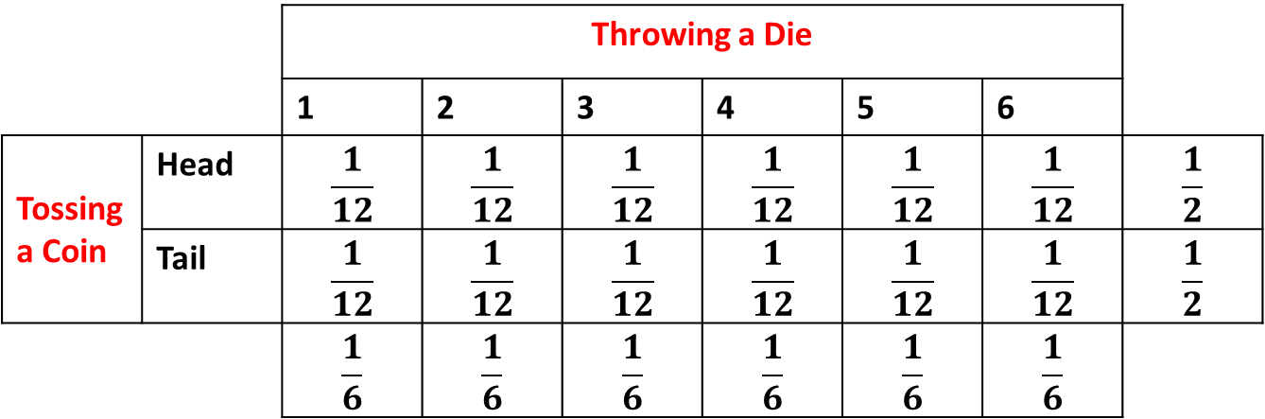
Types of Probability
Can either be marginal, joint or conditional.
Marginal Probability: If A is an event, then the marginal probability is the probability of that event occurring, P(A).
Example: Let we toss a coin (first event) and throw a dice (second event).
 |  | Throwing a Die
 |  | 1 | 2 | 3 | 4 | 5 | 6
Tossing a Coin | Head | $$\frac{1}{12}$$ | $$\frac{1}{12}$$ | $$\frac{1}{12}$$ | $$\frac{1}{12}$$ | $$\frac{1}{12}$$ | $$\frac{1}{12}$$ | $$\frac{1}{2}$$
 | Tail | $$\frac{1}{12}$$ | $$\frac{1}{12}$$ | $$\frac{1}{12}$$ | $$\frac{1}{12}$$ | $$\frac{1}{12}$$ | $$\frac{1}{12}$$ | $$\frac{1}{2}$$
 |  | $$\frac{1}{6}$$ | $$\frac{1}{6}$$ | $$\frac{1}{6}$$ | $$\frac{1}{6}$$ | $$\frac{1}{6}$$ | $$\frac{1}{6}$$
Marginal probability

Slide 10
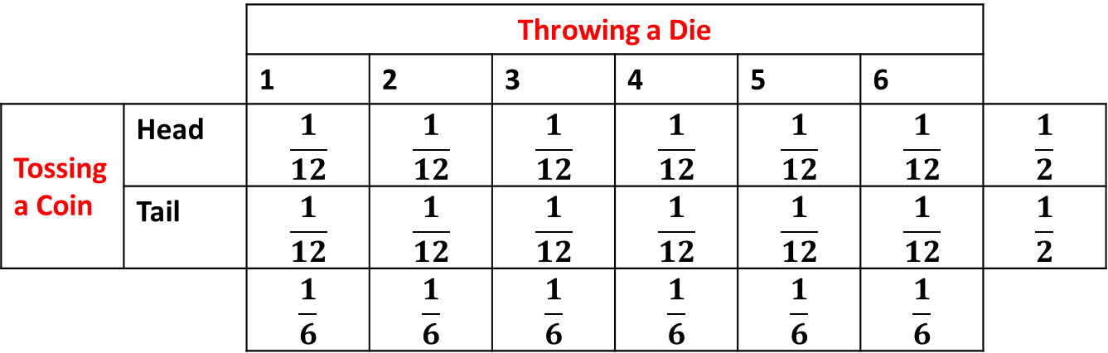

Types of Probability
Can either be marginal, joint or conditional.
Joint Probability: The probability of the intersection of two or more events.
If A and B are two events then the joint probability of the two events is written as $P(A ∩ B)$ or, $P(X=x, Y=y), X$and Y are random variables.
 |  | Throwing a Die
 |  | 1 | 2 | 3 | 4 | 5 | 6
Tossing a Coin | Head | $$\frac{1}{12}$$ | $$\frac{1}{12}$$ | $$\frac{1}{12}$$ | $$\frac{1}{12}$$ | $$\frac{1}{12}$$ | $$\frac{1}{12}$$ | $$\frac{1}{2}$$
 | Tail | $$\frac{1}{12}$$ | $$\frac{1}{12}$$ | $$\frac{1}{12}$$ | $$\frac{1}{12}$$ | $$\frac{1}{12}$$ | $$\frac{1}{12}$$ | $$\frac{1}{2}$$
 |  | $$\frac{1}{6}$$ | $$\frac{1}{6}$$ | $$\frac{1}{6}$$ | $$\frac{1}{6}$$ | $$\frac{1}{6}$$ | $$\frac{1}{6}$$
Joint probability
Marginal probability

Slide 11
Types of Probability
Can either be marginal, joint or conditional.
Conditional Probability: The conditional probability is the probability that some event(s) occur given that we know other events have already occurred. If A and B are two events, then the conditional probability of A occurring given that B has occurred is written as P(A|B) or P(X=x|Y=y).
Example: the probability that a card is a four given that we have drawn a red card is P(4|red) = 2/26 = 1/13.

Slide 12
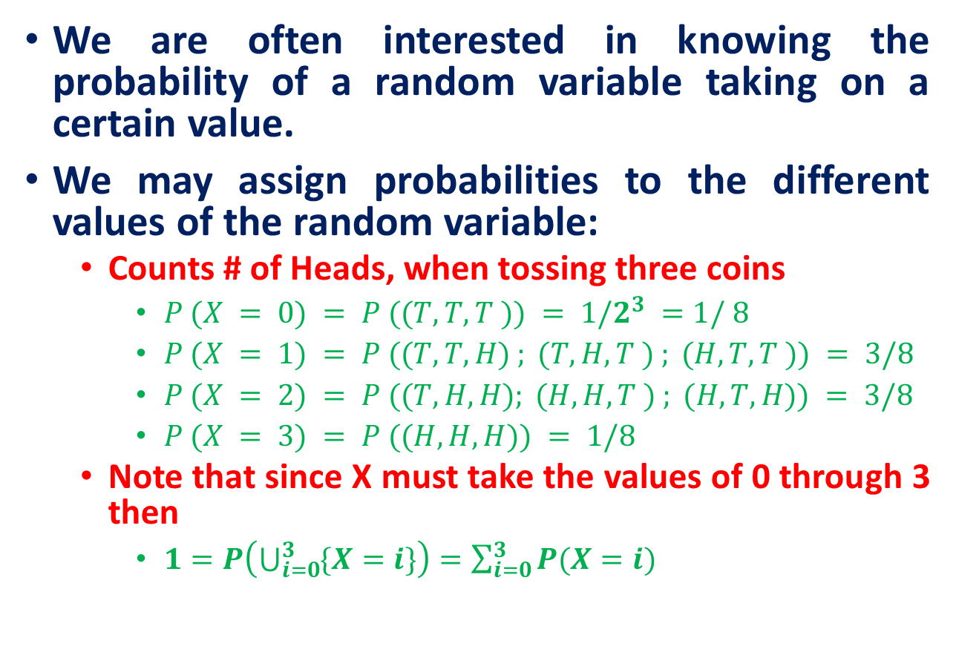
Probability Functions
We are often interested in knowing the probability of a random variable taking on a certain value.
We may assign probabilities to the different values of the random variable:
Counts # of Heads, when tossing three coins
$P (X = 0) = P ((T, T,T )) = 1/2^{3} =1/ 8$
$P (X = 1) = P ((T,T,H) ; (T,H,T ) ; (H,T,T )) = 3/8$
$P (X = 2) = P ((T,H, H); (H,H,T ) ; (H, T,H)) = 3/8$
$P (X = 3) = P ((H, H,H)) = 1/8$
Note that since X must take the values of 0 through 3 then
$1=P\left(\bigcup_{i=0}^{3}{\{X=i\}}\right)=\sum_{i=0}^{3}{P(X=i)}$
Probabilities for random variables can be computed from the probability measure defined on underlying sample space.

Slide 13
Probability Functions
A probability function maps the possible values of x against their respective probabilities of occurrence, p(x)
p(x) is a number from 0 to 1.0.
The area under a probability function is always 1.
Discrete example: roll of a die
Which of the following are probability functions?
a. f(x)=.25 for x=9,10,11,12
b. f(x)= (3-x)/2 for x=1,2,3,4
c. f(x)= (x²+x+1)/25 for x=0,1,2,3
p(x)
1/6
1
2
3
4
5
6
x

Slide 14
Probability Distributions and Probability Mass Functions
Definition: Probability Distribution
A probability distribution of a random variable X is a description of the probabilities associated with the possible values of X
Example
Let X = # of heads observed when a coin is flipped twice
Number of Heads | 0 | 1 | 2
Probability | 1/4 | 2/4 | 1/4

Slide 15
Probability Distributions and Probability Mass Functions
The probability distribution of a discrete random variable is a graph, table, or formula that specifies the probability associated with each possible value the random variable can assume.
Requirements for the Probability Distribution of a Discrete Random Variable X
p(x) ≥ 0 for all values of x
Σ p(x) = 1
Example: (Probability defined by function p(x))
x | 1 | 2 | 3 | 4
P(X = x) = f(x) | 0.1 | 0.2 | 0.3 | 0.4
Function of X: p(x) = $\frac{1}{10}x$ for $x ∈ \{1, 2, 3, 4\}$

Slide 16
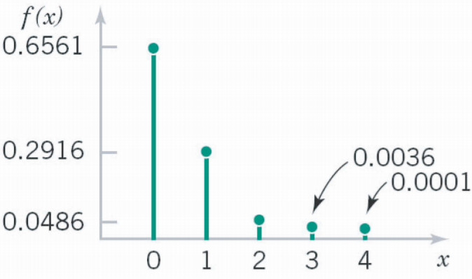
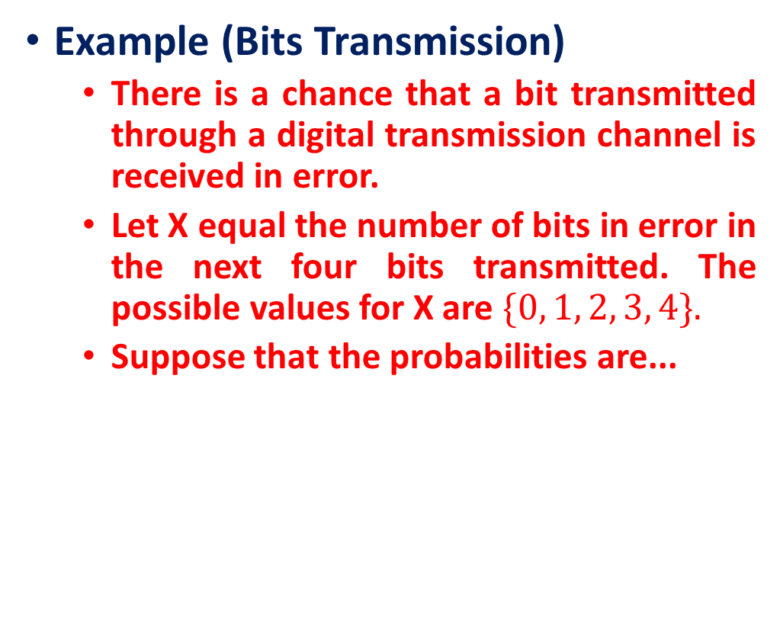
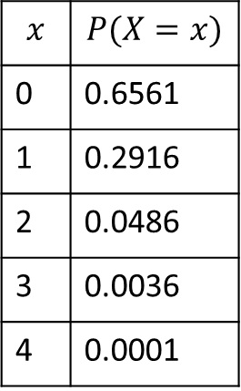
Probability Distributions and Probability Mass Functions
Example (Bits Transmission)
There is a chance that a bit transmitted through a digital transmission channel is received in error.
Let X equal the number of bits in error in the next four bits transmitted. The possible values for X are $\{0, 1, 2, 3, 4\}.$
Suppose that the probabilities are...
The probability distribution shown graphically
$$x$$ | $$P(X=x)$$
0 | 0.6561
1 | 0.2916
2 | 0.0486
3 | 0.0036
4 | 0.0001

Slide 17
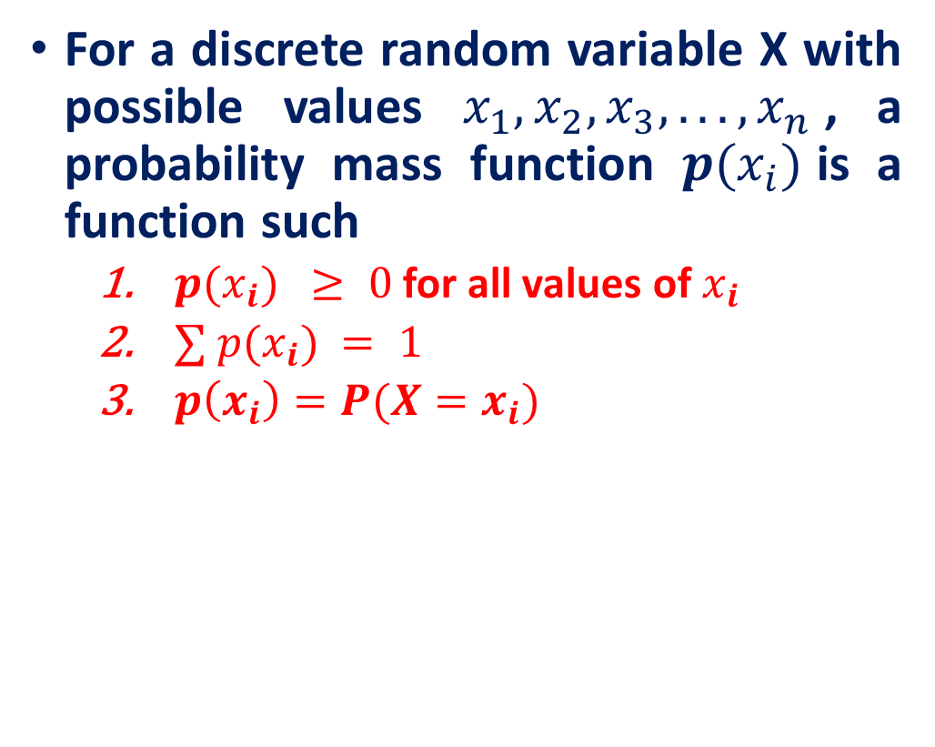
Probability Mass Function (PMF)
Example (Probability Mass Function (PMF)): Tossing a die
For a discrete random variable X with possible values $x_{1}, x_{2}, x_{3}, . . . , x_{n}$, a probability mass function $p(x_{i})$is a function such
$p(x_{i}) ≥ 0$ for all values of $x_{i}$
$∑ p(x_{i}) = 1$
$p\left(x_{i}\right)=P(X=x_{i})$
x
p(x)
1
p(x=1)=1/6
2
p(x=2)=1/6
3
p(x=3)=1/6
4
p(x=4)=1/6
5
p(x=5)=1/6
6
p(x=6)=1/6
The probability distribution for a discrete random variable is described with a probability mass function (probability distributions for continuous random variables will use different terminology).
1.0

Slide 18
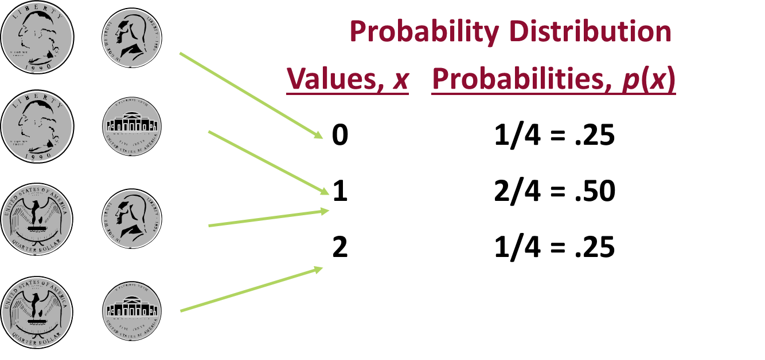
Discrete Probability Distribution Example
Experiment: Toss 2 coins. Count number of tails.

Slide 19
Visualizing Discrete Probability Distributions
Table
Listing
f(x)
p(x)
{ (0, .25), (1, .50), (2, .25) }
# Tails
Count
0
1
.25
1
2
.50
2
1
.25
Graph
p(x)
.50
Formula
.25
n
!
p
(
x
x
)
=
p^{x}(1 – p)^{n – x}
.00
x!(n – x)!
0
1
2

Slide 20
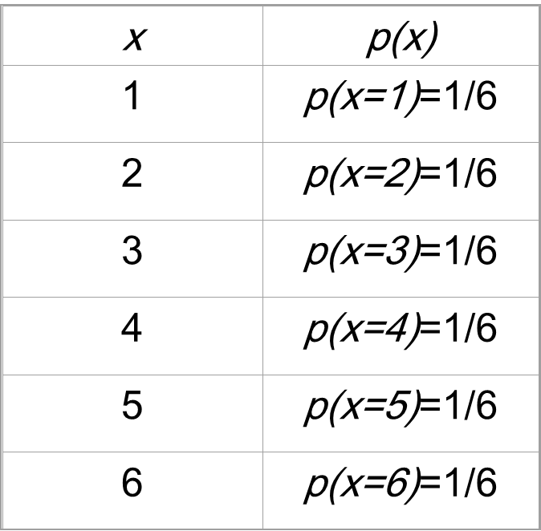

Cumulative Distribution Function (CDF)
Sometimes it’s useful to quickly calculate a cumulative probability, or $P(X ≤ x)$, denoted as $F(x)$, which is the probability that X is less than or equal to some specific x.
Example: Toss a die, then the probability mass function for X

Slide 21
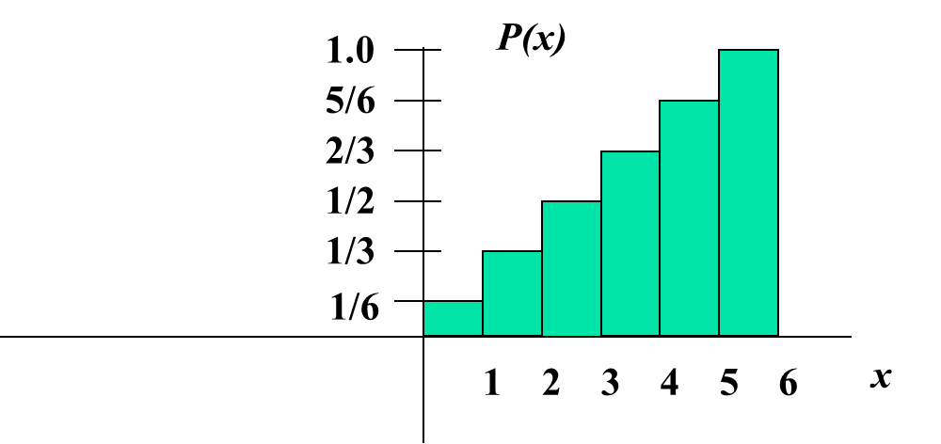
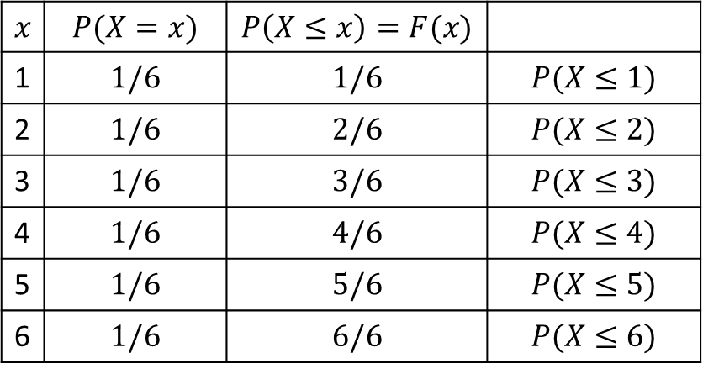
Cumulative Distribution Function (CDF)
Cumulative
Probabilities
Suppose we’re interested in the probability of getting 3 or less
P(X ≤ 3) = P(X = 1) + P(X = 2) + P(X = 3)=3/6=1/2
$$x$$ | $$P(X=x)$$ | $$P\left(X≤x\right)=F(x)$$
1 | $$1/6$$ | $$1/6$$ | $$P(X≤1)$$
2 | $$1/6$$ | $$2/6$$ | $$P(X≤2)$$
3 | $$1/6$$ | $$3/6$$ | $$P(X≤3)$$
4 | $$1/6$$ | $$4/6$$ | $$P(X≤4)$$
5 | $$1/6$$ | $$5/6$$ | $$P(X≤5)$$
6 | $$1/6$$ | $$6/6$$ | $$P(X≤6)$$
As x increases across the possible values for x, the cumulative probability increases, eventually getting 1, as you accumulate all the probability.

Slide 22
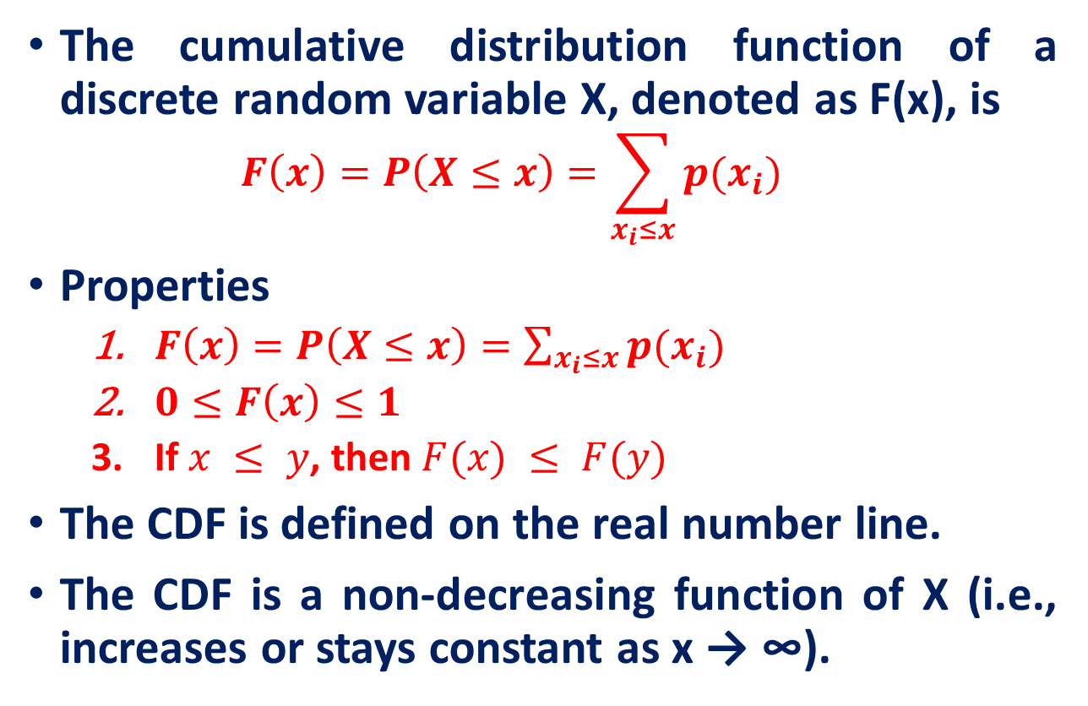
Cumulative Distribution Function (CDF)
The cumulative distribution function of a discrete random variable X, denoted as F(x), is
$$F\left(x\right)=P\left(X≤x\right)=\sum_{x_{i}≤x}{p(x_{i})}$$
Properties
$F\left(x\right)=P\left(X≤x\right)=\sum_{x_{i}≤x}{p(x_{i})}$
$0≤F\left(x\right)≤1$
If $x ≤ y$, then $F(x) ≤ F(y)$
The CDF is defined on the real number line.
The CDF is a non-decreasing function of X (i.e., increases or stays constant as x → ∞).

Slide 23
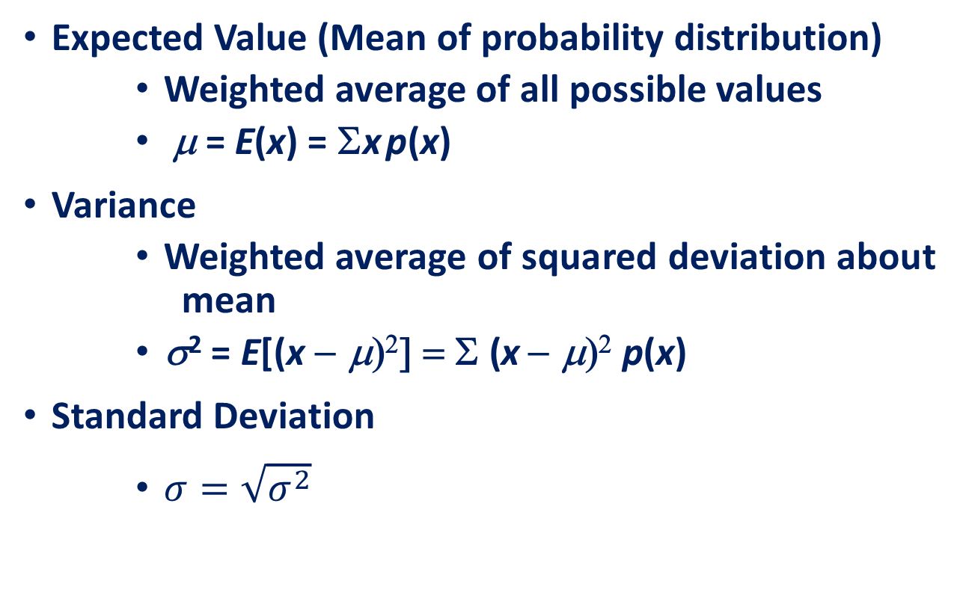
Summary Measures
Expected Value (Mean of probability distribution)
Weighted average of all possible values
μ = E(x) = Σx p(x)
Variance
Weighted average of squared deviation about mean
σ² = E[(x − μ)²] = Σ (x − μ)² p(x)
Standard Deviation
$σ=\sqrt{σ^{2}}$

Slide 24
Summary Measures Calculation Table
Experiment: Toss 2 coins. Count number of tails.
x
p(x)
x p(x)
x – μ
(x – μ)²
(x – μ)²p(x)
Total
Σx p(x)
Σ(x − μ)² p(x)

Slide 25
Summary Measures Calculation Table
Experiment: Toss 2 coins. Count number of tails.
x
p(x)
x p(x)
x – μ
(x – μ) ²
(x – μ) ²p(x)
0
.25
0
–1.00
1.00
.25
1
.50
.50
0
0
0
2
.25
.50
1.00
1.00
.25
μ
= 1.0
σ² = .50
σ = .71

Slide 26
Practice Problem
The number of ships to arrive at a harbor on any given day is a random variable represented by x. The probability distribution for x is:
Question: Find the probability that on a given day:
a. exactly 14 ships arrive
b. At least 12 ships arrive
c. At most 11 ships arrive
x
10
11
12
13
14
P(x)
.4
.2
.2
.1
.1
p(x=14)= .1
p(x≥12)= (.2 + .1 +.1) = .4
p(x≤11)= (.4 +.2) = .6

Slide 27
Practice Problem
You are lecturing to a group of 1000 students. You ask them to each randomly pick an integer between 1 and 10. Assuming, their picks are truly random:
What percentage of the students would you expect picked a number less than or equal to 6?
Since p(x≤ 6) = 1/10 + 1/10 + 1/10 + 1/10 + 1/10 + 1/10 =.6
= 60%

Slide 28
Reference
Lecture notes on Probability Theory by Phanuel Mariano

